Slide 1
PROFESSIONAL ETHICS – ESB 402 ENGINEERS COMMITMENT TO SAFETY
Faculty of engineering
Sri lanka technological campus
5th April 2024

Slide 2
TOPICS
Safety and Risk
Assessing and Reducing Risk
Normalising Deviance
Construction Site Safety
Factory Safety
Case Study – Bhopal Gas Leak
Engineer’s Liability for Risk

Slide 3
SAFETY AND RISK
On July 28, 1945, a twin-engine B-25 bomber lost in the fog crashed into the Empire State Building 914 feet above street level. It tore an 18-by-2-foot hole in the north face of the building and scattered flaming fuel into the building. New York firemen put out the blaze in 40 minutes. The crew members and 10 persons at work perished. The building was repaired and still stands.
Just 10 years later, in 1955, the leaders of the New York City banking and real estate industries got together to initiate plans for the New York City World Trade Center, which would later become known as the Twin Towers, the world’s tallest buildings. However, as the plans emerged, it became clear that the buildings required new construction techniques and the easing of old building code requirements.

Slide 4
SAFETY AND RISK
On September 11, 2001, terrorists attacked the Twin Towers by flying two hijacked 727 passenger jets into them, each jet smashing approximately two-thirds of the way up its respective tower. The first consequence of the attack was the fire that started over several floors by high-octane aviation fuel. The fires isolated more than 2,000 workers in the floors above them. Only 18 of the more than 2,000 were able to descend the flaming stairwells to safety. Most of the 2,000 perished in the later collapse of the buildings.
For an engineer, 9/11 raises questions of how this structural failure could have happened, why the building codes did not better protect the public, and how such a disaster can be prevented in the future. There are even larger questions about acceptable risk and the proper approach to risk as an issue of public policy.

Slide 5
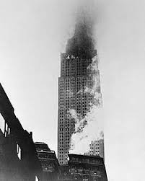
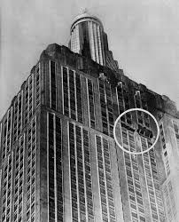
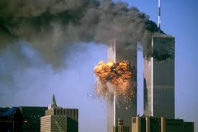
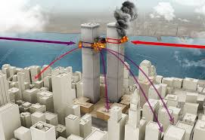
SAFETY AND RISK
1945 Empire State Building
2001 Twin Tower Attack

Slide 6
SAFETY AND RISK
The concern for safety is a common one for engineers. How should engineers deal with issues of safety and risk, especially when they involve possible liability for harm?
In the Twin Towers case, the risk was increased by the earlier weakening of building codes and the use of new structural designs that were untested, even though the building codes required such testing.
This illustrates an important fact: Engineering necessarily involves risk, and innovation usually increases the risks. One cannot avoid risk simply by remaining with tried and true designs, but innovation creates technologies in which the risks are not fully understood, thereby increasing the chance of failure. Without innovation, there is no progress.
Thus, risk is inherent in engineering.

Slide 7
SAFETY AND RISK
We demand safe products and services, but we also realize that there is a cost involved, and we may have to pay for this safety.
To complicate matters, what may be safe enough for one person may not be for someone else because of different perceptions about what is safe
A power saw in the hands of a child will never be as safe as it can be in the hands of an adult.
A sick adult is more prone to suffer ill effects from air pollution than is a healthy adult.
Absolute safety, in the senses of (a) entirely risk-free activities and products, or (b) a degree of safety that satisfies all individuals or groups under all conditions, is neither attainable nor affordable..

Slide 8
SAFETY AND RISK
The relationship of safety to risk is an inverse one. Because of the laws of engineering science and statistics, the more we accept risk in an engineering project, the less safe it will become.
If there were absolutely no risk in a project, then that project would be absolutely safe. So safety and risk are intimately connected. Concern for safety is a part of engineering practice.
One of the most common concepts in engineering practice is the notion of ‘‘factors of safety.’’ If the largest load a walkway will have to carry at any one time is 1,000 kg, for example, then a prudent engineer might design the walkway geometry to carry 3,000 kg. The walkway dimensions for normal usage would then be designed with a factor of safety of three on geometry.

Slide 9
SAFETY AND RISK
Virtually all engineering codes give a prominent place to safety, stating that engineers must hold paramount the safety, health, and welfare of the public. The first Fundamental Canon of the IESL Code of Ethics requires members to ‘‘hold paramount the safety, health, and welfare of the public.’’
In Clause 5.2, it instructs engineers not to ‘‘complete, sign, or seal plans and/or specifications that are not in conformity with applicable engineering standards.’’
Clause 1.5, instructs engineers that if their professional judgment in circumstances that endanger life or property is overruled, they shall notify their employer or client and such other authority as may be appropriate.

Slide 10
SAFETY AND RISK
A RISK is the potential that something unwanted and harmful may occur
Risk, like harm, is a broad concept covering many different types of unwanted occurrences. In regard to technology, it can equally well include dangers of bodily harm, of economic loss, or of environmental degradation. These in turn can be caused by delayed job completion, faulty products or systems, or economically or environmentally injurious solutions to technological problems.

Slide 11
SAFETY AND RISK
Good engineering practice has always been concerned with safety. But as technology’s influence on society has grown, so has public concern about technological risks increased
ACCEPTABILITY OF RISK :
This is influenced by such factors as
whether the risk is accepted voluntarily;
the effects of knowledge on how the probabilities of harm (or benefit) are known or perceived;
if the risks are job-related or other pressures exist that cause people to be aware of or to overlook risks;
whether the effects of a risky activity or situation are immediately noticeable or are close at hand;
and whether the potential victims are identifiable beforehand.

Slide 12
ASSESSING AND REDUCING RISK
Any improvement in safety as it relates to an engineered product is often accompanied by an increase in the cost of that product.
Conversely, products that are not safe incur secondary costs to the manufacturer beyond the primary (production) costs that must also be taken into account :
costs associated with warranty expenses,
loss of customer goodwill,
loss of customers because of injuries sustained from the use of the product,
litigation,
possible downtime in the manufacturing process, and so forth.
It is therefore important for manufacturers and users alike to reach some understanding of the risks connected with any given product and know what it might cost to reduce those risks (or not reduce them).

Slide 13
ASSESSING AND REDUCING RISK
DIFFICULTIES IN ASSESSING RISK
Risk is seldom intentionally designed into a product. It arises because of the many uncertainties faced by the design engineer, the manufacturing engineer, and even the sales and applications engineer.
It would be desirable, to be able to accurately predict the harm resulting from engineering work – THEN THERE IS NO RISK !!
Instead, engineers can only estimate the magnitude and probability of harm. To make matters worse, often engineers cannot even make estimates satisfactorily.
In actual practice, therefore, estimating risk (or ‘‘risk assessment’’) involves an uncertain prediction of the probability of harm.

Slide 14
ASSESSING AND REDUCING RISK
DETECTING FAILURE MODES
A failure mode is a way in which a structure, mechanism, or process can malfunction
With respect to new technologies, engineers and scientists must have some way of estimating the risks that they impose on those affected by them.
One of the methods for assessing risk involves the use of a Fault Tree.
In a Fault Tree Analysis [FTA], we begin with an undesirable event, such as a car not starting or the loss of electrical power to a nuclear power plant’s safety system. We reason back to the events that might have caused this undesirable event.
Fault Trees are often used to anticipate hazards for which there is little or no direct experience, such as nuclear meltdowns. They enable an engineer to analyze systematically the various failure modes attendant to an engineering project.
.

Slide 15
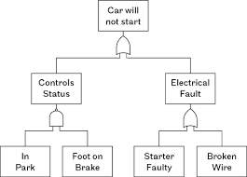
ASSESSING AND REDUCING RISK
Fault Tree Analysis (FTA) is one of the most important logic and probabilistic techniques used in Probabilistic Risk Assessment (PRA) and system reliability assessment today.

Slide 16
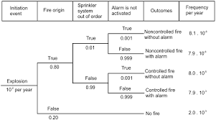
ASSESSING AND REDUCING RISK
Event Tree Analysis (ETA) is a forward, top-down, logical modeling technique for both success and failure that explores responses through a single initiating event and lays a path for assessing probabilities of the outcomes and overall system analysis.

Slide 17
NORMAILIZING DEVIANCE
Another factor that increases risk and also decreases our ability to anticipate harm is increasing the allowable deviations from proper standards of safety and acceptable risk. (Diane Vaughn – Sociologist)
Every design carries with it certain predictions about how the designed object should perform in use. Sometimes these predictions are not fulfilled, producing what are commonly referred to as anomalies. Rather than correcting the design or the operating conditions that led to anomalies, engineers or managers too often may simply accept the anomaly or even increase the boundaries of acceptable risk. Sometime this process can lead to disaster.
Sump leak
Challenger seals
Discovery foam shedding

Slide 18
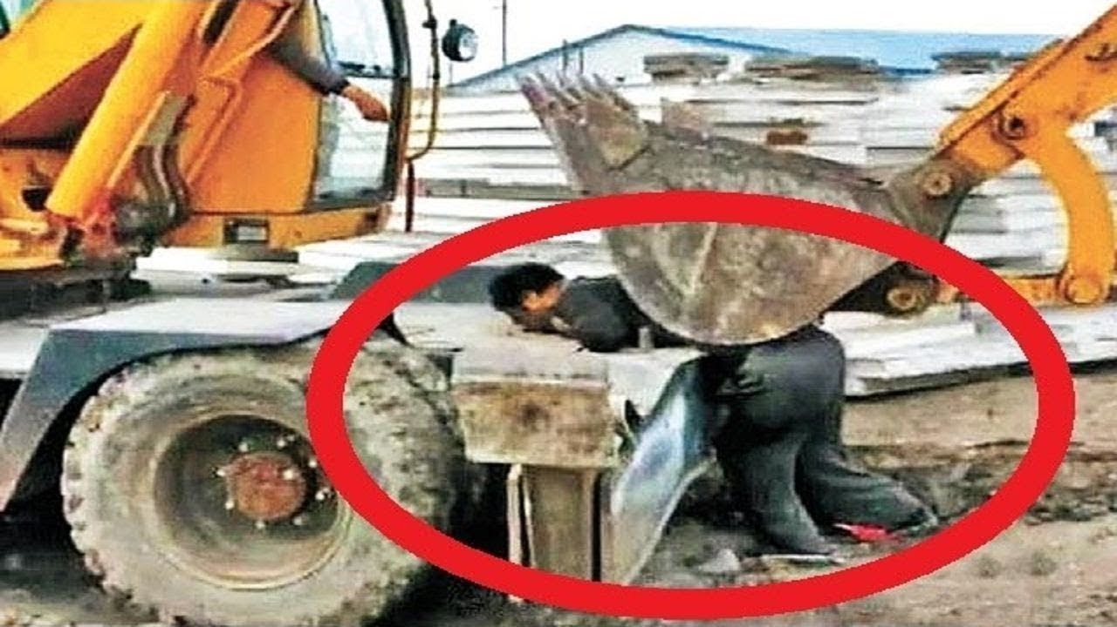
Construction site safety
Some of the potential hazards that construction workers face include:
Falls from heights
Scaffold collapse
Electrocution
Trench collapse
Repetitive motion injuries
Failure to use the required PPE
(Personal Protective Equipment) A bad accident !!

Slide 19
Construction site safety
Fall Protection
Duty to have fall protection is the most cited standard in the construction industry and is one of the leading causes of worker deaths in construction. Employers need to assess job sites and implementing fall protection systems to protect workers.
Scaffolds :
Approximately 65% of all construction workers perform work on scaffolds. Employees performing work on and around scaffolding are exposed to falls, electrocutions and falling object hazards.

Slide 20
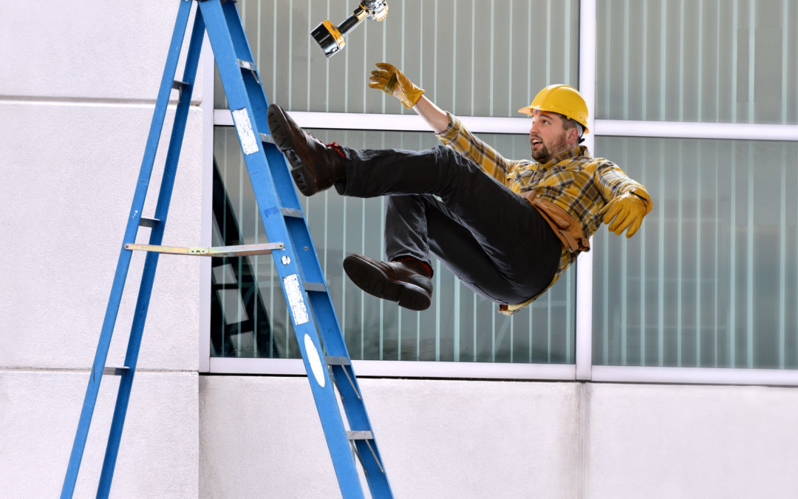
Construction site safety
Construction work is one of the most dangerous professions, and work on the job site is where most accidents occur. Employers do need to mitigate safety hazards to construction workers, but workers need to keep in mind a lot of precautions themselves when working in such hazardous conditions. Thus, construction industry leaders must strive to safeguard their employees — if not for ethical reasons, then for the economic ones
Awareness
Training
Communication
Documentation
Proper Equipment
Supervision
Innovation
Transparency

Slide 21
Construction site safety
Awareness:
Before any worker — no matter his or her role or experience level — can set foot on a construction site, he or she must be fully aware of the possible hazards. Ignorant workers are perhaps the biggest dangers in any industry, as their unknowing mistakes put everyone else at risk.
It is the Engineer’s (construction manager’s) job to make sure that every worker is aware of the dangers that come with working on a construction site and they must be responsible for protecting workers from these dangers

Slide 22
Construction site safety
Training :
Though most of a construction worker’s skills can be gained on the job, safety is one skill set that is best learned before workers enter the construction site..
Experienced workers should be expected to refresh their knowledge of standard safety by attending regular training sessions throughout the year.
Without the proper training, construction workers can be easily injured or even killed.
In such an environment where injuries and fatalities are highly likely, training is necessary and it is the responsibility of the Engineer (construction manager) to ensure that site workers are adequately trained, because workplace injuries will hurt all ethically and economically.

Slide 23
Construction site safety
Communication :
Accidents are more likely to occur when workers are unsure what to expect. Direct discussion of the day’s goals and activities will cut down on surprises that could cause bodily harm.
Construction firms should equip workers with smartphones, walkie-talkies, or headsets, which allow fast and efficient communication among team members.

Slide 24
Construction site safety
Documentation :
To enforce construction site safety, there must be proper documentation of everything that is going to be done on-site. There are some legal requirements and construction companies must ensure that all proper registrations and licenses are earned before work begins.
Not only does this prevent accidents due to improper training, but it protects the construction firm from legal action and public scrutiny. Any safety hazards that make their way to the media will look bad for construction firms.
The Engineer (construction manager) must ensure that all necessary Permits relevant to the site work are available and authorization enforced before the work starts

Slide 25
Construction site safety
Proper Equipment :
To create a culture centered around construction site safety, workers need to be given the proper Personal Protective Equipment (PPE). Without the proper PPE, there will be no construction site safety, because there will always be an opportunity to injured.
Minimum PPE requirements for Construction Sites
A helmet has to be supplied and worn at all times at the construction site
Safety glasses must be provided to protect workers against debris in the air
Safety/high-visibility vests must be provided and worn to keep workers visible
Protective gloves should be supplied and worn to protect hands against cuts
Proper clothing is a must for worker protection both indoors and outdoors
Safety and Anti-slip footwear is also necessary

Slide 26
Construction site safety
Proper Equipment :
Additional PPE Requirements
Hearing protection must be worn near any tool, machine or equipment that produces loud noises
Respiratory protection is needed to protect against dust and other air contaminants
Face shields are a must for welding operations and other debris/spark producing operations
Safety harnesses must be used as a safety procedure to prevent falls
The Engineer (construction manager) must ensure that personal protective equipment and gear must be provided to construction workers. .

Slide 27
Construction site safety
Supervision :
Ideally, construction workers would fully understand the consequences of inadequate safety precautions and thus act in a manner to ensure site-wide well-being — but this is not a perfect world. Every site must have a strong supervisor who is willing and capable of enforcing safety standards with no exceptions. This foreman must keep tabs on all employees throughout the day and correct those who fail to commit to proper construction site safety procedures.
Innovation :
The Engineer (construction manager) together with his/her staff must also helps develop new ideas for keeping construction workers safe, while also encouraging them to contribute with their ideas.
The development of new practices that will enhance safety should always be encouraged, and companies should avoid speaking against legislation aimed at improving safety protocols..

Slide 28
Construction site safety
Transparency :
The worst thing any construction firm can do for its reputation is attempting a cover-up. Hiding accidents from the press and the public not only lowers the opinion of the firm — it paints the engineering industry as a whole in a negative light.
Ultimately, people understand that accidents happen, and as long as contractors are doing their best to foster a safe environment for their workers, any accidents that do occur will only contribute to the growing need to augment modern safety techniques.
A safer construction industry is an industry of fewer injuries, fewer workplace accidents, and fewer deaths. The Engineer (construction manager) is the key player in achieving this goal !!!

Slide 29
INDUSTRIAL site safety
Factories Ordinance (No. 45 of 1942)
AN ORDINANCE TO MAKE PROVISION FOR THE SAFETY AND WELFARE OF WORKERS IN FACTORIES.
PART I - REGISTRATION OF FACTORIES AND APPROVAL OF FACTORY BUILDINGS
PART II - HEALTH (GENERAL PROVISIONS)
PART III - SAFETY (GENERAL PROVISIONS)
PART IV - WELFARE (GENERAL PROVISIONS)
PART V - HEALTH, SAFETY AND WELFARE (SPECIAL PROVISIONS AND REGULATIONS)
PART VI - NOTIFICATION AND INVESTIGATION OF ACCOUNTS AND INDUSTRIAL DISEASES
PART VII - EMPLOYMENT OF WORKERS
PART VIII - SPECIAL APPLICATIONS AND EXTENSIONS PREMISES IN RESPECT OF WHICH OWNER IS LIABLE
PART IX to XV – ADMINISTATION and GENERAL

Slide 30
INDUSTRIAL site safety
Hoists and lifts.
Every hoist or lift shall be thoroughly examined by a competent person at least once in every period of twelve months
Every hoistway or liftway shall be efficiently protected by a substantial enclosure fitted with gates, being such an enclosure as to prevent, when the gates are shut, any person falling down the way or coming into contact with any moving part of the hoist or lift.
Chains, ropes and lifting tackle.
all chains, ropes and lifting tackle in use shall be thoroughly examined by a competent person at least once in every period of six months or at such greater intervals as determined by the Commissioner
Cranes and other lifting machines.
All such parts and gear, whether fixed or moving, shall be thoroughly examined by a competent person at least once in every period of fourteen months and a register shall be kept containing such particulars of every examination as may be prescribed.

Slide 31
INDUSTRIAL site safety
Steam Boilers.
Every steam boiler and all its fittings and attachments shall be thoroughly examined by a person who is the holder of a certificate issued in that behalf by the Commissioner at least once in every period of twelve months, and also after any extensive repairs:
No person shall attend on or operate any steam boiler unless he is authorized in writing by the holder of a certificate issued above. No person shall be authorized under this section unless after compliance with such requirements as may be prescribed.
Steam receivers and steam containers.
Every steam receiver and its fittings shall be properly maintained and shall be thoroughly examined by a person who is the holder of a certificate issued in that behalf by the Commissioner, so far as the construction of the receiver permits, at least once in every period of twenty-four months.

Slide 32
INDUSTRIAL site safety
Air receivers.
Every air receiver shall be thoroughly cleaned and examined at least once in every period of twenty-four months:
Gas receivers.
Every gas receiver and its fittings shall be thoroughly cleaned and examined at least once in every period of twelve months:
Every such examination and test shall be carried out by a person who is the holder of a certificate issued in that behalf by the Commissioner and a report of the result of every such examination and test, containing such particulars as may be prescribed (including particulars of the safe working pressure) shall be entered in or attached to the general register

Slide 33
THE ENGINEERS LIABILITY FOR SAFETY / RISK
Engineers need to protect themselves from undue liability for risk, but this need sometimes raises important issues for social policy. Some issues they may face are :
Can an employed engineer be sued separate and apart from the engineer's employer being sued?
Will there by sufficient insurance coverage to protect the individual employed engineer?
What is the likelihood that an individual will be sued apart from the employer?
What about individuals employed in government?

Slide 34
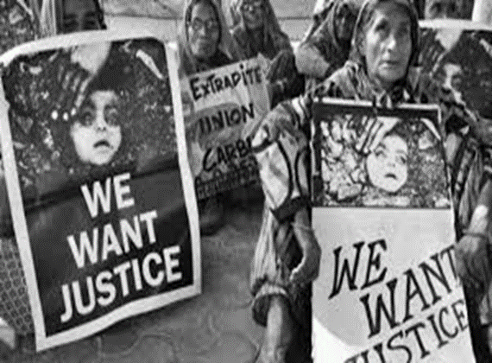
The Bhopal gas leak tragedy 1984

Slide 35
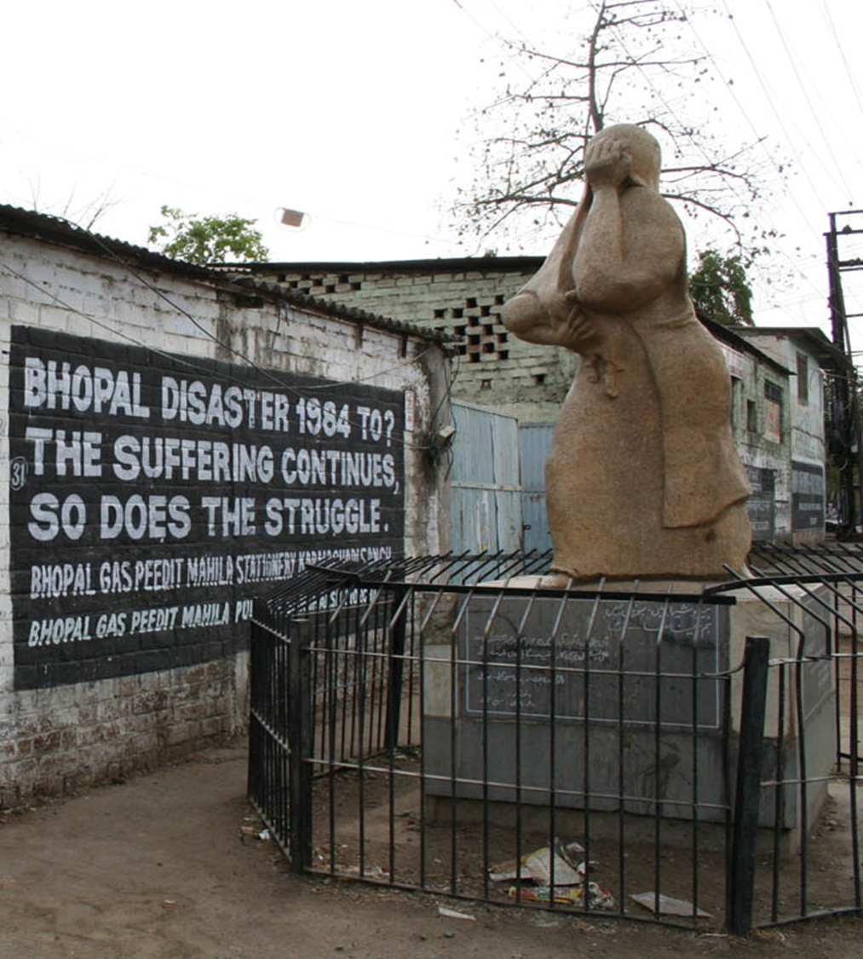
Monument
Dedicated to the
Victims

Slide 36
BACKGROUND
The Bhopal Gas Tragedy, was a gas leak incident on the night of 2–3 December 1984 at the Union Carbide India Limited (UCIL) pesticide plant in Bhopal, Madhya Pradesh, India. It is considered to be the world's worst industrial disaster. Over 500,000 people were exposed to methyl isocyanate (MIC) gas. The highly toxic substance made its way into and around the small towns located near the plant.
The cause of the disaster remains under debate. The Indian Government and local activists argue that slack management and deferred maintenance created a situation where routine pipe maintenance caused a backflow of water into a MIC tank, triggering the disaster. Union Carbide Corporation (UCC) argues water entered the tank through an act of sabotage.

Slide 37
BACKGROUND
Estimates vary on the death toll. The official immediate death toll was 2,259. In 2008, the government of Madhya Pradesh had paid compensation to the family members of 3,787 victims killed in the gas release, and to 574,366 injured victims. Others estimate that 8,000 died within two weeks, and another 8,000 or more have since died from gas-related diseases.
The UCIL factory was built in 1969 to produce carbaryl for pesticides, using methyl isocyanate (MIC) imported from UCC factories elsewhere. An MIC production plant was added to the UCIL site in 1979
After the Bhopal plant was built, other manufacturers produced carbaryl without MIC, though at a greater manufacturing cost. UCIL continued to use MIC.

Slide 38
Operation - Liquid MIC storage
The Bhopal UCIL facility housed three underground 68,000-liter liquid MIC storage tanks:
UCC safety regulations specified that no one tank should be filled more than 50% (here, 30 tons) with liquid MIC. Each tank was pressurized with inert nitrogen gas. This pressurization allowed liquid MIC to be pumped out of each tank as needed, and also kept impurities out of the tanks.
In late October 1984, tank E610 lost the ability to effectively maintain its nitrogen gas pressure, which meant that the liquid MIC contained within could not be pumped out. At this time tank E610 contained 42 tons of liquid MIC.
Shortly after this failure, MIC production was halted at the Bhopal facility for maintenance. Maintenance included the shutdown of the plant's flare tower
With the flare tower still out of service, production of carbaryl was resumed in late November, using MIC stored in the two tanks still in service.
An attempt to re-establish pressure in tank E610 failed, so the 42 tons of liquid MIC contained within, still could not be pumped out of it.

Slide 39
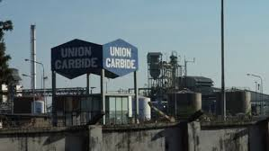
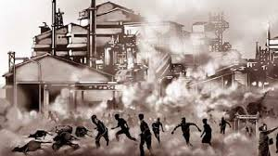
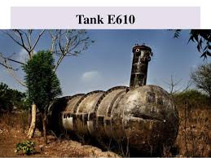
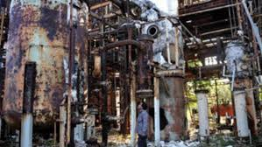

Slide 40
Operation – the gas release
By early December 1984, most of the plant's MIC related safety systems were malfunctioning and many valves and lines were in poor condition. In addition, several vent gas scrubbers had been out of service as well as the steam boiler, intended to clean the pipes.
During the late evening hours of 2 December 1984, water was believed to have entered a side pipe and into Tank E610, having 42 tons MIC, whilst trying to unclog it.
The introduction of water into the tank subsequently resulted in a runaway exothermic reaction, which was accelerated by contaminants, high ambient temperatures and other factors.
The pressure in tank continued to rise: senior refinery employees assumed the reading was due to instrumentation malfunction.
the reaction in tank E610 reached a critical state at an alarming speed, with temperatures and the pressure in the tank rapidly increasing. The emergency relief valve burst open, and pressure in the tank continued to increase; this despite the fact that atmospheric venting of toxic MIC gas had already begun.]
:

Slide 41
Operation – the gas release
Direct atmospheric venting should have been prevented or at least partially mitigated by at least three safety devices which were malfunctioning, not in use, insufficiently sized or otherwise rendered inoperable
A refrigeration system meant to cool tanks containing liquid MIC, shut down in January 1982, and whose freon had been removed in June 1984. Since the MIC storage system required refrigeration, its high temperature alarm, set to sound at 11 °C (52 °F) had long since been disconnected.]

Slide 42
Operation – the gas release
A flare tower, to burn the MIC gas as it escaped, which had had a connecting pipe removed for maintenance, and was improperly sized to neutralise a leak of the size produced by tank E610
A vent gas scrubber, which had been deactivated at the time and was in 'standby' mode, and similarly had insufficient caustic soda and power to safely stop a leak of the magnitude produced
About 30 tonnes of MIC escaped from the tank into the atmosphere in 45 to 60 minutes. This would increase to 40 tonnes within two hours.
The gases were blown in a southeasterly direction over Bhopal.

Slide 43
EFFECTS
The initial effects of exposure were coughing, severe eye irritation and a feeling of suffocation, burning in the respiratory tract, breathlessness, stomach pains and vomiting. People awakened by these symptoms fled away from the plant.
Owing to their height, children and other residents of shorter stature inhaled higher concentrations, as methyl isocyanate gas is approximately twice as dense as air and, therefore, in an open environment has a tendency to fall toward the ground.^{[29]}
Thousands of people had died by the following morning.
Within a few days, trees in the vicinity became barren and bloated animal carcasses had to be disposed of. 170,000 people were treated at hospitals and temporary dispensaries, and 2,000 buffalo, goats, and other animals were collected and buried. Supplies, including food, became scarce owing to suppliers' safety fears. Fishing was prohibited causing further supply shortages.

Slide 44
Ethical Issues - Risk Assessment
This whole disaster started from the lack of risk assessment.
The root of this problem was in locating the site for the factory 4.8 km from the city centre of Bhopal, as the UCC thought that the place is strategic for transportation of goods
a civic minded engineer should be able to foresee the future impact of setting up this factory at the chosen location, where a disastrous accident could happen resulting from human errors or faulty machinery.
In saving the cost of production to gain more income, UCC insisted on picking the place closer to the town center to cut down the cost of transportation even though it is too dangerous for the local citizens who live nearby.
Corporate goals over-riding concerns for the “safety, health and welfare” of the community.

Slide 45
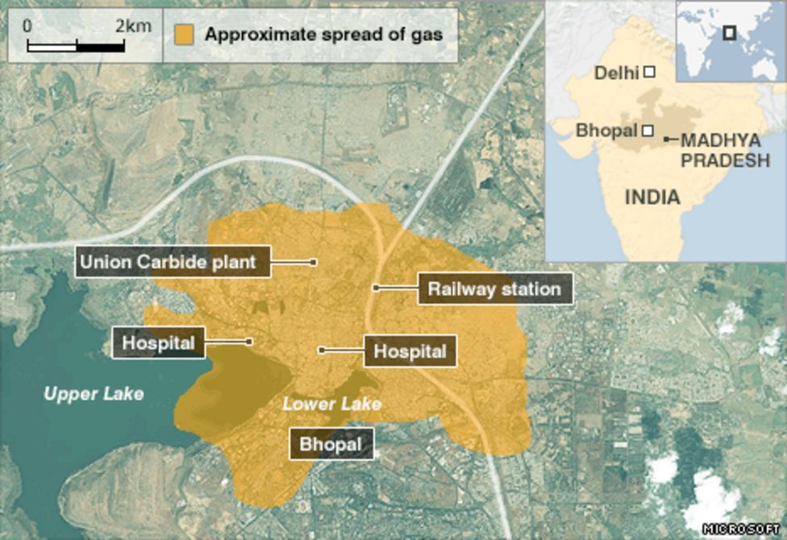
Ethical Issues - Risk Assessment
The action of approving the proposal for the site of this project was professionally unethical for an engineer.
Overlooking the health and safety of the community / failure to object to location of selected factory site

Slide 46
Ethical Issues -Responsibility for Safety
Responsibility for safety is the most important aspect and highest ethical priority of any industry. Engineers must avoid catastrophic failure which could result in loss of property, damage to the environment, and possibly injury or loss of life. The safety, health and welfare of the employees, employers and even the public are of utmost important. A proper EMERGENCY RESPONSE PLAN is a must !!
However, most of the safety systems in the plant were not in operating order.
The vent gas scrubber designed to neutralize the gas was shut down as it was deemed unnecessary during periods when production was suspended.
Moreover, the flare tower could only handle a quarter of the gas that leaked in 1984, and it was out of order because of a repair
To reduce energy costs, the refrigeration system had been shut down for 5 months,
Most of the instrumentation was defective or non-operational
Disregard for safety, with commercial goals over-riding essential engineering needs

Slide 47
Ethical Issues -Responsibility for Safety
Safety Audits were done annually in US and European factories, but every two years in other parts of the world
Bias against third world countries in not carrying out Safety Audits at the period globally / Conflict of Interest – cost of Audit
The tanks storing the MIC gas were overloaded more than 60 percent of capacity based on UCC manuals. The purpose of this is to allocate extra space to dilute the gases in case of emergencies.
Deviation from standard procedures / disregard for safety

Slide 48
Ethical Issues -Responsibility for Safety
Another aspect of responsibility of safety is that the workers were not given proper training / education on the safety procedures. Use of low cost workers reduced UCIL’s expenditure, but the company responsibility was in keeping the workspace safe and accident-free.
Corporate goals taking precedence over technical requirements
Investigations highlight a gradual deterioration of safety practices in regard to the MIC, which had become less relevant to plant operations.
By 1984, only six of the original twelve operators were still working with MIC and the number of supervisory personnel had also been halved. No maintenance supervisor was placed on the night shift and instrument readings were taken every two hours, rather than the previous and required one-hour readings.
Corporate goals taking precedence over technical requirements

Slide 49
Ethical Issues -Responsibility for Safety
Workers made complaints about the cuts through their union but were ignored. One employee was fired after going on a 15-day hunger strike.
70% of the plant's employees were fined before the disaster for refusing to deviate from the proper safety regulations under pressure from the management.
Corporate goals taking precedence over technical requirements
UCIL and the engineers of the chemical plant failed to ethically adhere to their responsibilities towards safety, and their negligence had ultimately cost the community dearly.

Slide 50
ETHICAL Issues - Responsibility
Furthermore, after the disaster breakdown, the director of UCC in UCIL moved back to America, denying the breakdown at the factory was related to him or his company.
He stated that the breakdown was caused by the human errors which came from the workers at the factory and not the management nor the top personnel
The action of UCC denying responsibility for the tragedy and blaming the low-class workers is professionally unethical. They took advantage of the illiterate and uneducated workers of the factory to run away from the blame.
As a result, the government of India fined the UCC in United States for all the loss of lives related to the factory breakdown with the amount of $470 million, and distributed to the family of deceased.

Slide 51
Ethical Issues - Conflict of Interest
In the Bhopal factory, UCIL sought to minimize cost to obtain higher profits as its main motive and priority.
This indirectly lowered the quality of man power, specialization, skill level and morality of workers of the plant .
After the year 1982, safety practices were neglected due to this conflict of interest. This was partly due to a
high turnover of employees,
failure to train new employees’ effectively and
low technical preparedness of the local labour pool.
The recruitment and retainment of quality employees for the right job was not preserved, thus giving room for accidents to happen as it was no longer a safe, healthy and supportive workplace.

Slide 52
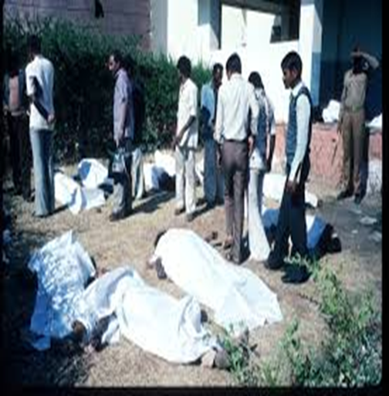
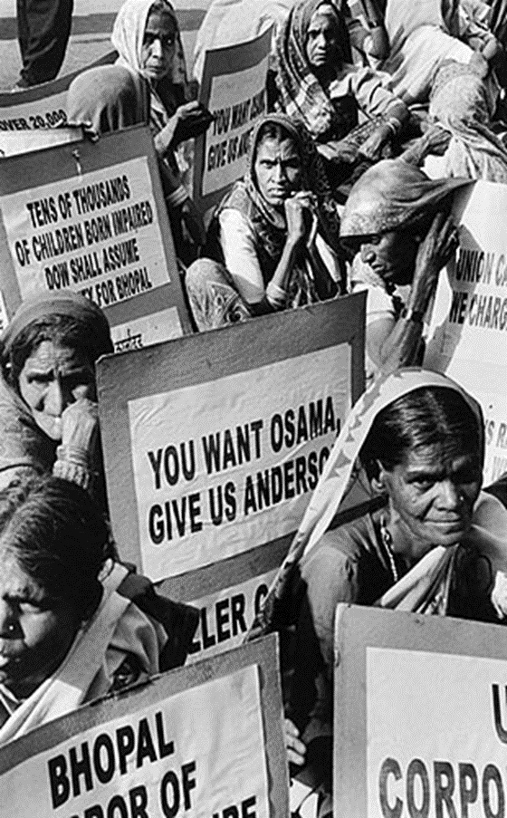
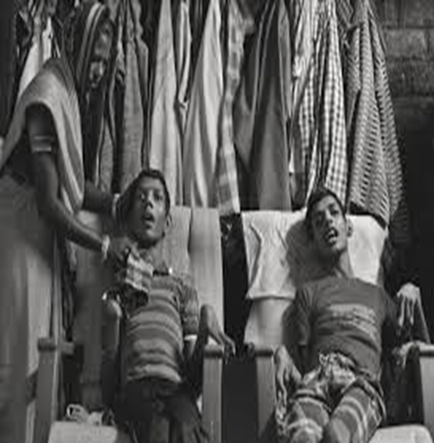
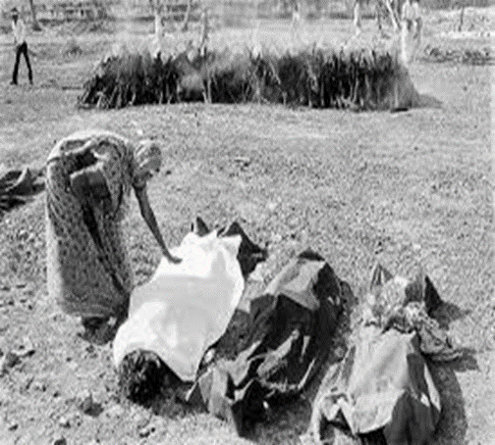
THE AFTERMATH

Slide 53
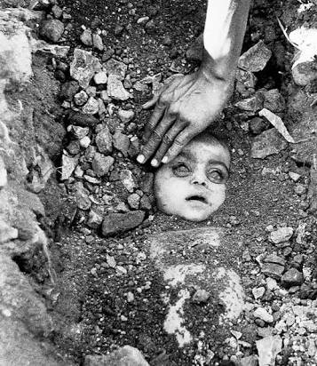
Bhopal Gas Disaster Girl Every particle of the soil felt your suffocation where you rested, surprisingly the cause of suffocation was still breathing normal.”
There were mass funerals and cremations. Photographer Pablo Bartholemew, on commission with press agency Rapho, took an iconic color photograph of a burial on December 4, Bhopal gas disaster girl. Another photographer present, Raghu Rai, took a black and white photo. The photographers did not ask for the identity of the father or child as she was buried, and no relative has since confirmed it. As such, the identity of the girl remains unknown. Both photos became symbolic of the suffering of victims of the Bhopal disaster, and Bartholomew’s went on to win the 1984 World Press Photo of the Year.

Slide 54


Slide 55
ACKNOWLEDGEMENTS:
Introduction to Engineering Ethics by Mike W. Martin Professor of Philosophy Chapman University and Roland Schinzinger Late Professor Emeritus of Electrical Engineering University of California, Irvine : McGraw Hill Higher Education : ISBN 978-0-07-248311-6 MHID 0-07-248311-3
Engineering Ethics concepts and cases by Charles E. Harris Texas A&M University, Michael S. Pritchard Western Michigan University and Michael J. Rabins Texas A&M University, Wadsworh Cengage Learning. Library of Congress Control Number: 2008924940 ISBN-13: 978-0-495-50279-1
https://www.system-safety.org/issc2018/wp-content/uploads/2018/05/Ericson-FTA_Tutorial.pdf
https://www.researchgate.net/figure/A-n-example-of-event-tree-analysis_fig1_235957458
https://www.constructconnect.com/blog/10-construction-site-safety-tips
https://esub.com/improve-construction-site-safety/
https://www.bing.com/images/search?view=detailV2&ccid
FACTORIES ORDINANCE No 45 of 1942
Tennet.eu/company/safety-at-tennet/safety-at-tennet/
https://www.uniassignment.com/essay-samples/construction/ethical-case-study-bhopal-disaster-construction-essay.php
https://en.wikipedia.org/wiki/Bhopal_disaster
https://www.slideshare.net/ankithkadri/bhopal-tragedy-27723477
https://medium.com/@mansimahur/bhopal-gas-disaster-girl-67c789a21fbf
https://www.dnaindia.com/india/report-hazardous-waste-of-union-carbide-to-be-disposed-of-govt-2360516
https://ichef.bbci.co.uk/news/976/mcs/media/images/46829000/gif/_46829097_bhopal_466.gif

Slide 56
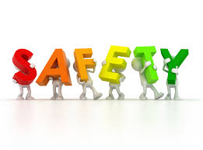

THANK YOU !!!!

